Slide 1
Web Engineering Project Proposal
Hotel Location Website

Slide 2
Objective
It will allow people to find nearest Hotels from their current location and show basic information about the Hotels.

Slide 3
Target Audience
The target Audience is the people who travel alot which may be due to work or other recreational activities.

Slide 4
Features
The featured offered by the website are that they allow service providers to pin their location on the map and users can view them when they search for places to stay nearest to them.

Slide 5
Management Plan
The website will be developed by Omer Khalid.
He will be responsible for creating all modules.
The estimated time line is twenty one Hours.
The budget is about 74%.

Slide 6
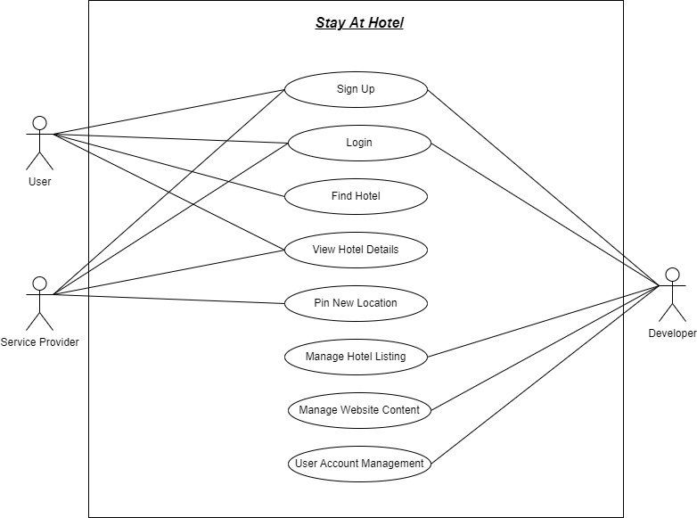
Use case Diagram

Slide 7
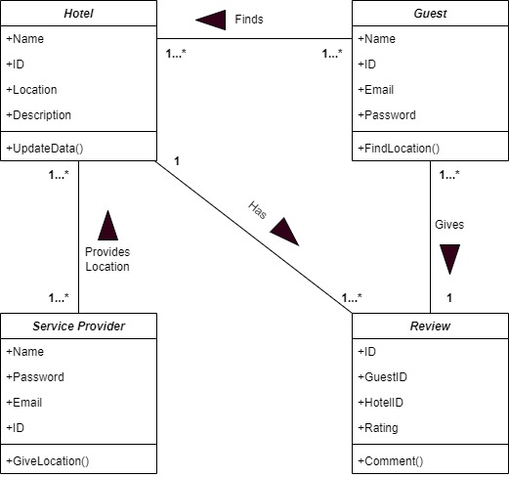
Class Diagram

Slide 8
The End

